Slide 1
ZOMATO ANALYSIS Group 4
Mr. Jignesh Patel
Mr. Jay Chauhan
Mr. Jyotiprasad Sarangi
Mr. Mohammad Salman Khan
Mr. Amit Mishra
Mr. Vaibhav Suryawanshi

Slide 2
Company Overview
Zomato is an Indian multinational restaurant aggregator and food delivery company.
It was founded by Deepinder Goyal and Pankaj Chaddah in 2008.
Zomato provides information, menus and user-reviews of restaurants as well as food delivery options from partner restaurants in more than 1,000 Indian cities and towns, as of 2022–23.

Slide 3
Dataset Overview
Dataset Name – Zomato
Dataset Format – XLSX (excel)
Sheets – 3 (Main, Country, Currency)
Columns – 24 Columns
Records – 9551
Modules- EXCEL , MYSQL , POWER BI , TABLEAU

Slide 4
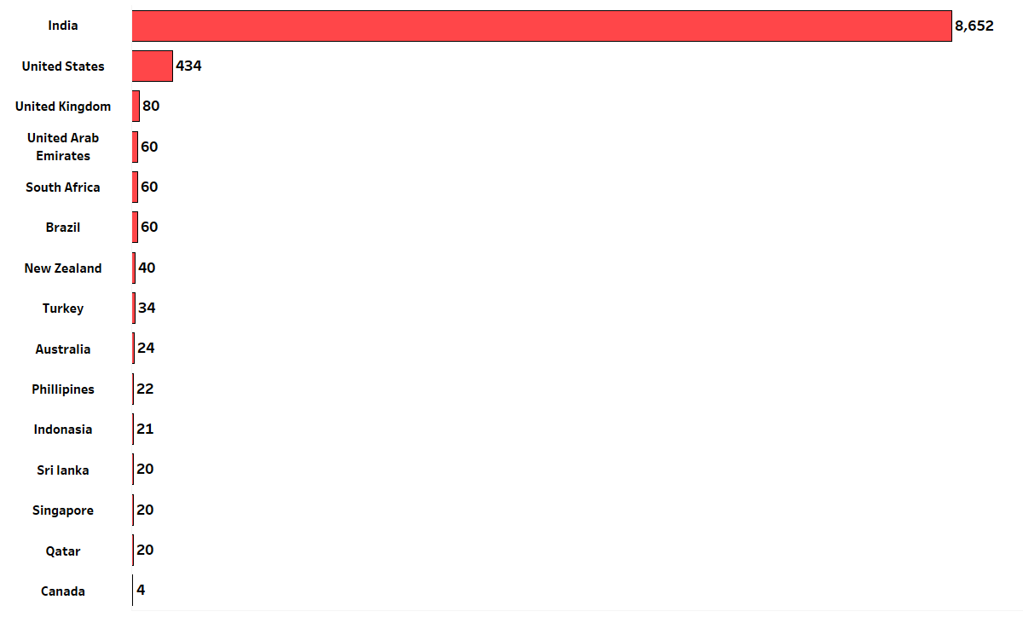
KPI 1.1 – Numbers of Restaurants based on Country
Observation-
India is having Highest Number of Restaurants(8652). (As Seen In Bar Graph)
As it is Indian Based Company
Canada is having Lowest Number of Restaurants(4).

Slide 5
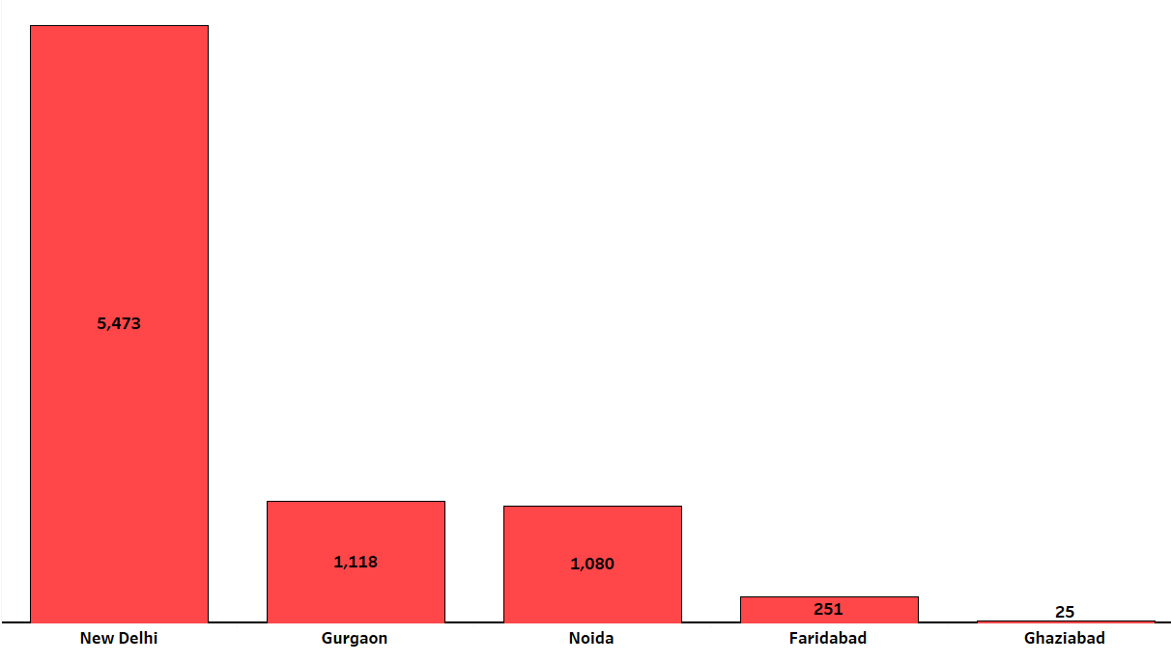
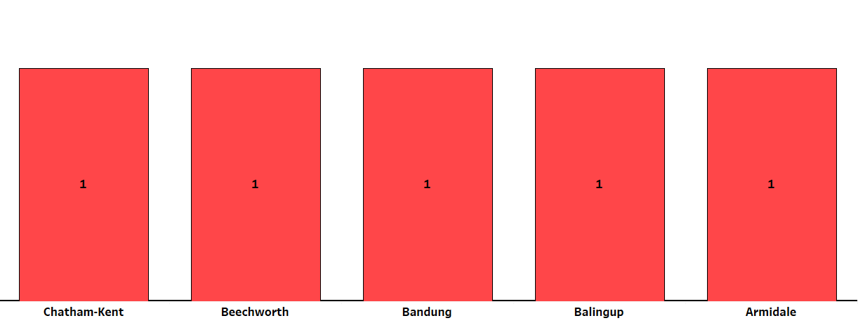
KPI 1.2 – Numbers of Restaurants based on City
Observation-
New Delhi is having Highest Number of Restaurants(5473) among all the cities. (As Seen In Column Chart)
Armidale and others (as shown in column chart) is having Lowest Number of Restaurants(1).
As We Can See All Indian Cities has more No. Of Restaurants than Foreign Cities.

Slide 6
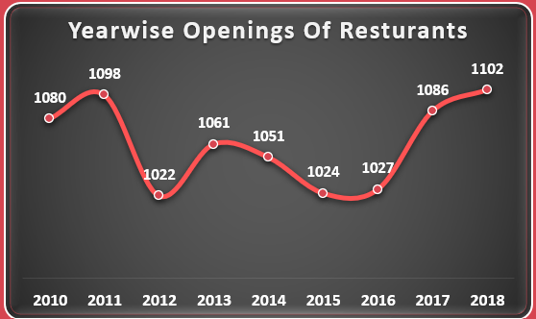
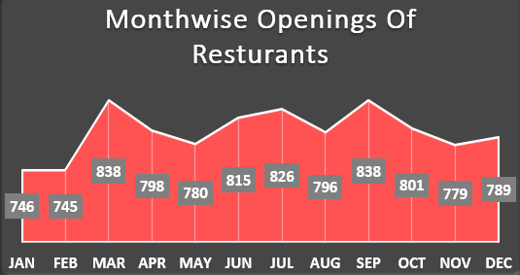
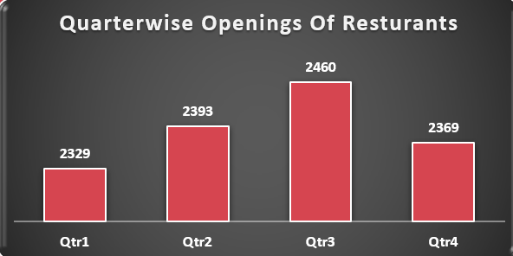
KPI 2 – Number of Restaurants opening based on Year , Quarter , Month
Observation –
Number Of Restaurants Over The Year has been almost same.(As we can see in Year wise Openings Of Restaurants)
Number Of Restaurants Over the Month among all the year has been grown in March & September(838).
Number Of Restaurants Over the Quarter among all the year has been grown in Quarter 3(2460).

Slide 7
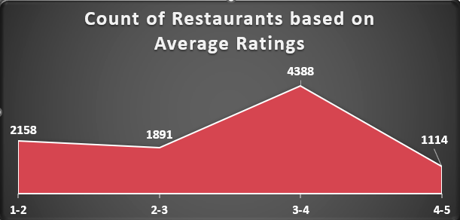
KPI 3 – Count of Restaurants based on Average Ratings
Observation –
Number Of Restaurants are Highest for rating between 3 to 4 (4388).
Number Of Restaurants are Lowest for rating between 4 to 5 (1114).

Slide 8
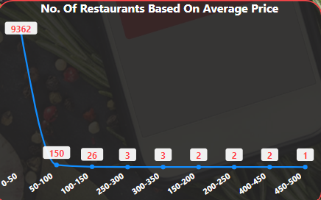
KPI 4 – Count of Restaurants based on Average PRICE
Observation –
Number Of Restaurants for Price Range 0$ to 50$ is Highest.(9362)
As Price Range Increases No. Of Restaurants Decreases.
Number Of Restaurants for Price Range 450$ to 500$ is Lowest.(1)

Slide 9
KPI 5 – Percentage of Restaurants based on "Has Table booking"
Observation –
Percentage Of Restaurants having Table Booking is only 12.12%(1158).
Percentage Of Restaurants not having Table Booking is almost 87.88%(8393).

Slide 10
KPI 6 – Percentage of Restaurants based on "Has Online delivery"
Observation –
Percentage Of Restaurants having Online Delivery is only 25.66% (2451).
Percentage Of Restaurants not having Online Delivery is almost 74.34%(7100).

Slide 11
Conclusion
Number Of Restaurants Opening Over the Period among all the Countries and Cities
are Adequate.
Customers have rated between 3 to 4 for most of the Restaurants on the basis of service provided.
For two persons, the majority of the Restaurants are charging less than 50$.
Most of the Restaurants doesn’t has Table Booking(almost 88%) and Online Delivery(almost 75%).

Slide 12
challenges
Converting data xlsx to csv for MySQL.
Performance issue – For MySQL it takes to much time to load csv file.
Date function is in Text – Convert into Date format.
Add new columns – Year, Month, Month-name, Quarter, Weekday No., Weekday Name, FM, FQ.
Use DAX Expression for finding Average Rating & Average Price.

Slide 13
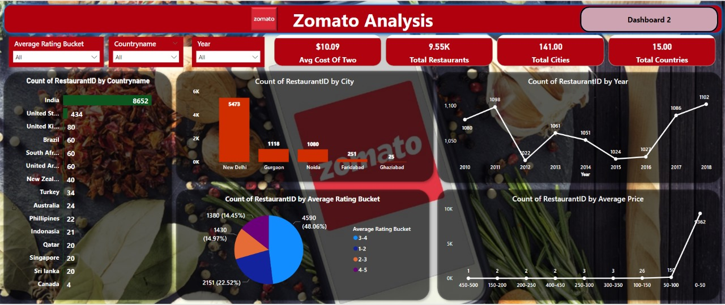

Slide 14
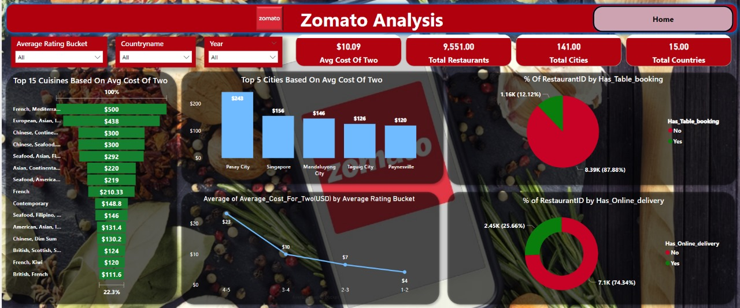

Slide 15
THANK YOU !!!

